Slide 1

By
Shubham Sanjay Sonawane
Guided By
Prof. Vidhaydhar J Aski
(Manipal University, Jaipur)
HEALTH +
IoT Enabled Ubiquitous Healthcare Data Acquisition and Monitoring System

Slide 2

Problem Statement
“Health monitoring, heart monitoring, rehabilitation, and assisted living for the elderly and medically challenged people on domestic basis.”

Slide 3
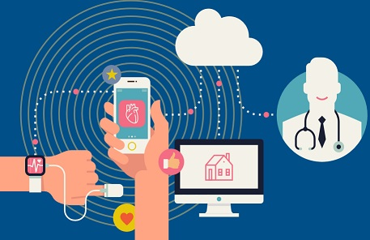
Proposed System
Various body sensors are connected to a microcontroller to track the status
Private Wi-Fi connection is used in order to transmit collected data and receive user requests.
This data is then shared with doctors through a web application.
Doctor can analyze the condition of the patient and provide further details online.
Patient or doctor can communicate with each other and view the past data any time they want.

Slide 4
Requirements
Hardware
Software
Arduino Uno
NodeMCU
Temp Sensor
Pulse Rate Sensor
ECG Module
OLED Display
Jumper Wires
Breadboard
Arduino IDE
Embedded C
Node.js
HTML, CSS and JavaScript
Python
MongoDB
Heroku
Git

Slide 5
Hardware Model
Sensors
DS18B20 - Digital temperature sensor.
High accuracy digital temperature sensor ideal for Body Temperature Measurement.
SEN-11574 Pulse rate sensor.
Popular infrared pulse rate sensor with analog output.
AD8232 ECG Module
AD8232 is low power 3.3 v device with inbuilt noise cancelation unit.
Microcontrollers
Arduino Uno
For sensor management
Node MCU
Inbuilt ESP8366 for Network Management.

Slide 6
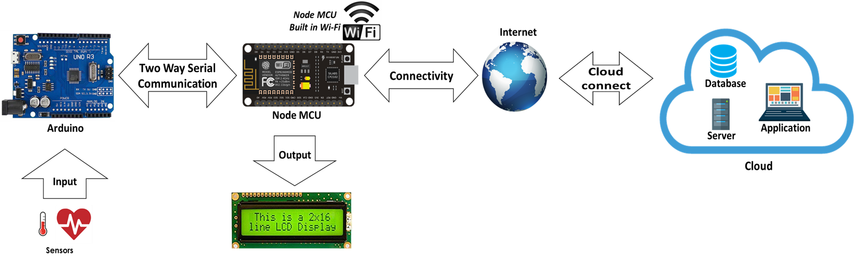
System Architecture

Slide 7
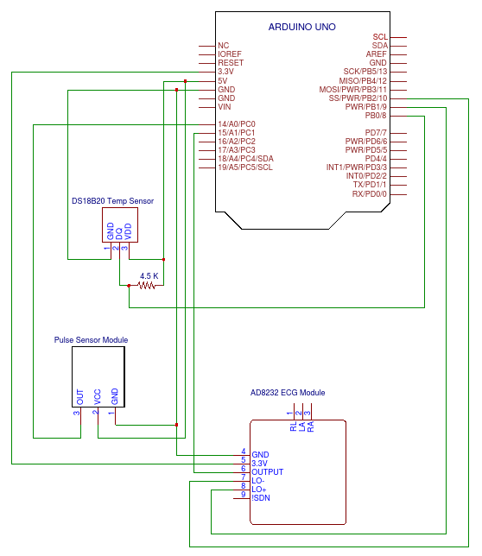
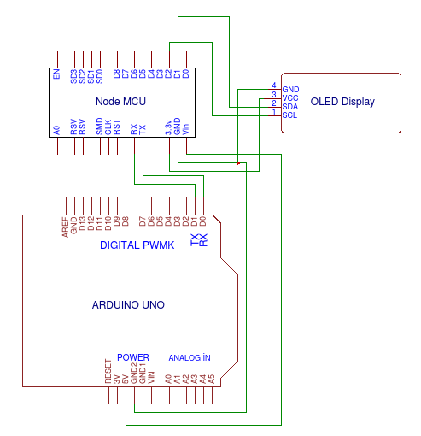
Circuit Diagram

Slide 8
Start
Temp
DS18B2 Temp Sensor function
Initialize Pin 8 to DS18B20
Initialize Pin 9,10 to AD8232 A,B
Initialize and A1 to AD8232 analog
Pulse
SEN-11574 Pulse Sensor
function
Read Incoming Serial Data
ECG
ECG Sensor function
If Serial Read Requested
X1
X1 Sensor function
Delay 500 ms
Write Outgoing Serial Data
Arduino Uno Flow Chart

Slide 9
Start
Delay 1000 ms
(wait for serial)
Initialize Wi-Fi Client Object
Initialize Wi-Fi Server Object
Initialize and Wi-Fi name and password
If Serial Incoming Available
Wait for Request
NodeMCU Flow Chart
Print data on Display and Send HTTP request with data to cloud server.
User HTTP Request Available
Delay 500 ms
Write Sensor Request on Outgoing Serial
End

Slide 10
Result And Observation Of Temperature Sensor
Temperature
(°F)
Time (Sec)

Slide 11
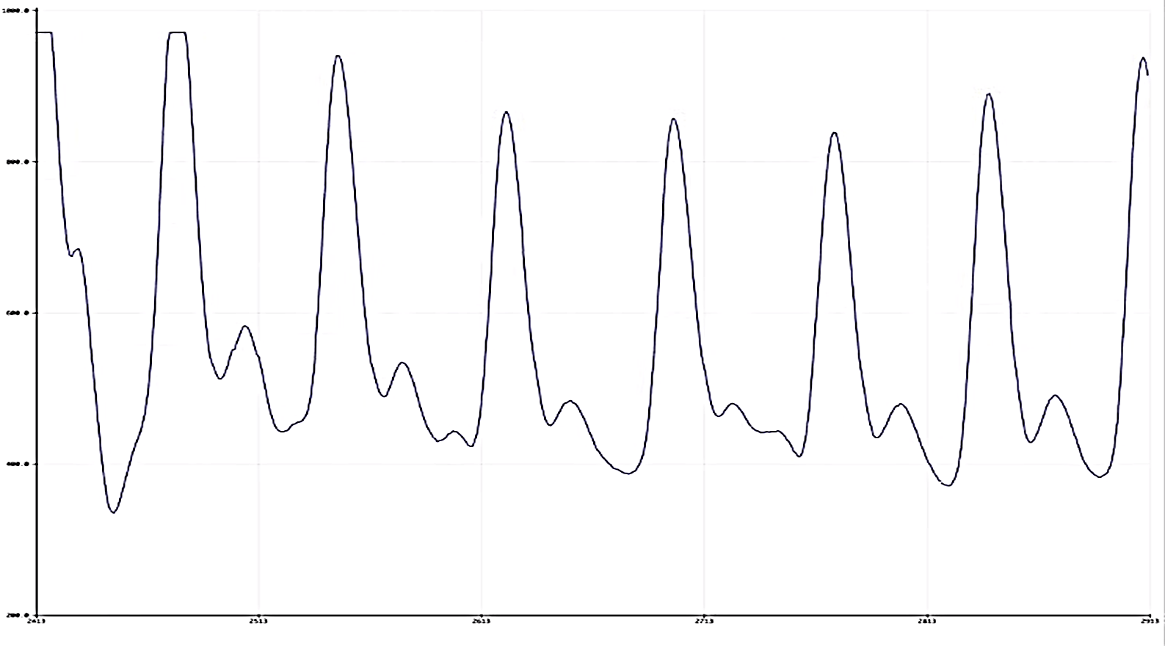
Approach And Observation Of Pulse Rate Sensor
ΔT
ΔT = T1 – T2
F = 1 / ΔT Beats/sec
= 1 / ΔT * 60 BPM
550
Threshold
Analog Input
Where,
T1 = Time of first beat
T2 = Time of Second beat
ΔT = Time Difference
F = Pulse Frequency
T1
T2
Time

Slide 12
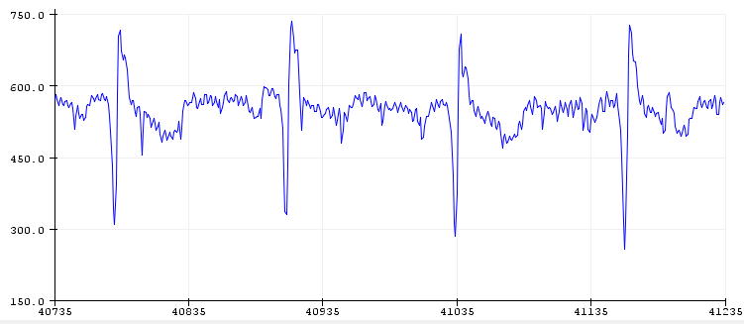
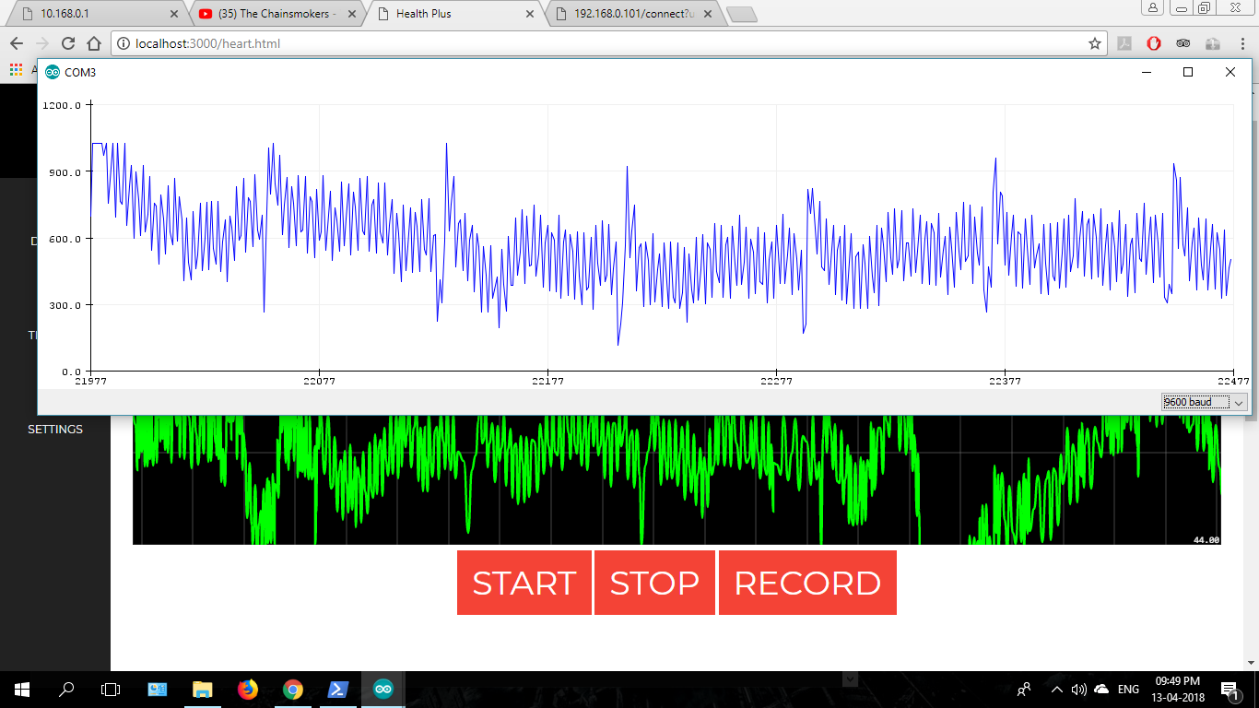
ECG Result And Observation
Electrodes Near Heart
Electrodes Away Heart

Slide 13
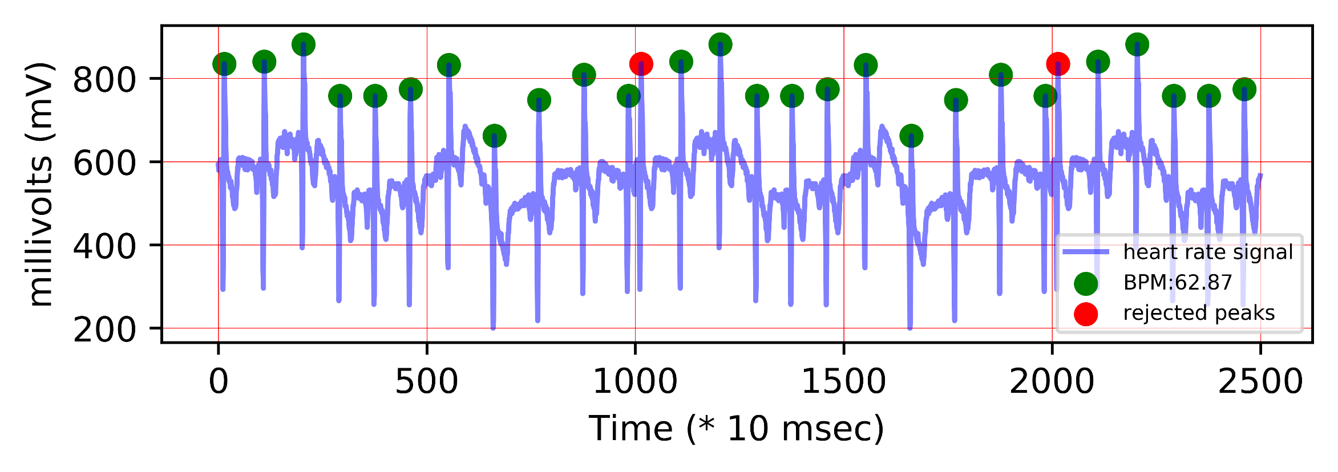
ECG Processing

Slide 14

Software
The software consist of web application and android application located on cloud.
We are done with the development of user interface of the website using basic web technology (HTML, JavaScript, CSS).
The middleware of the website will be developed using Node.js.
Technologies like Ajax and Web Sockets are to be used for real time update.
The Database will be developed in a document based databases like Mongo DB or Kairos DB.
This type of databases are highly compatible with JavaScript based technologies like Node.js. They allow us fetch data using query less techniques like Rest API.

Slide 15
Database
Users Collection
"User”: {
"User ID”: INT,
"Name”: STR,
"Email”: STR,
"DOB”:STR,
"Password”: STR,
"Phone”: INT,
"Chronic-Diseases”: STR,
"Blood-Group”: STR,
"Weight”: INT,
"Height”: INT,
"Description”: INT,
"My-Doctor”: Doctor
}
Health Parameter Collections
"Temperature" {
"User ID”: INT,
"Time-Stamp”: INT,
"Data”: INT
}
“Pulse-Rate" {
"User ID”: INT,
"Time-Stamp”: INT,
"Data”: INT
}
"ECG" {
"User ID”: INT
"Time-Stamp”: INT,
"Data"
}
Doctors Collection
"Doctor" {
"Doctor ID”: INT,
"Name”: STR,
"Hospital”: STR,
"Phone”: INT,
"Email”: STR,
"Password”: STR,
"Qualification”: STR,
"Specialization”: STR,
"Patients”: Array<User>
}

Slide 16
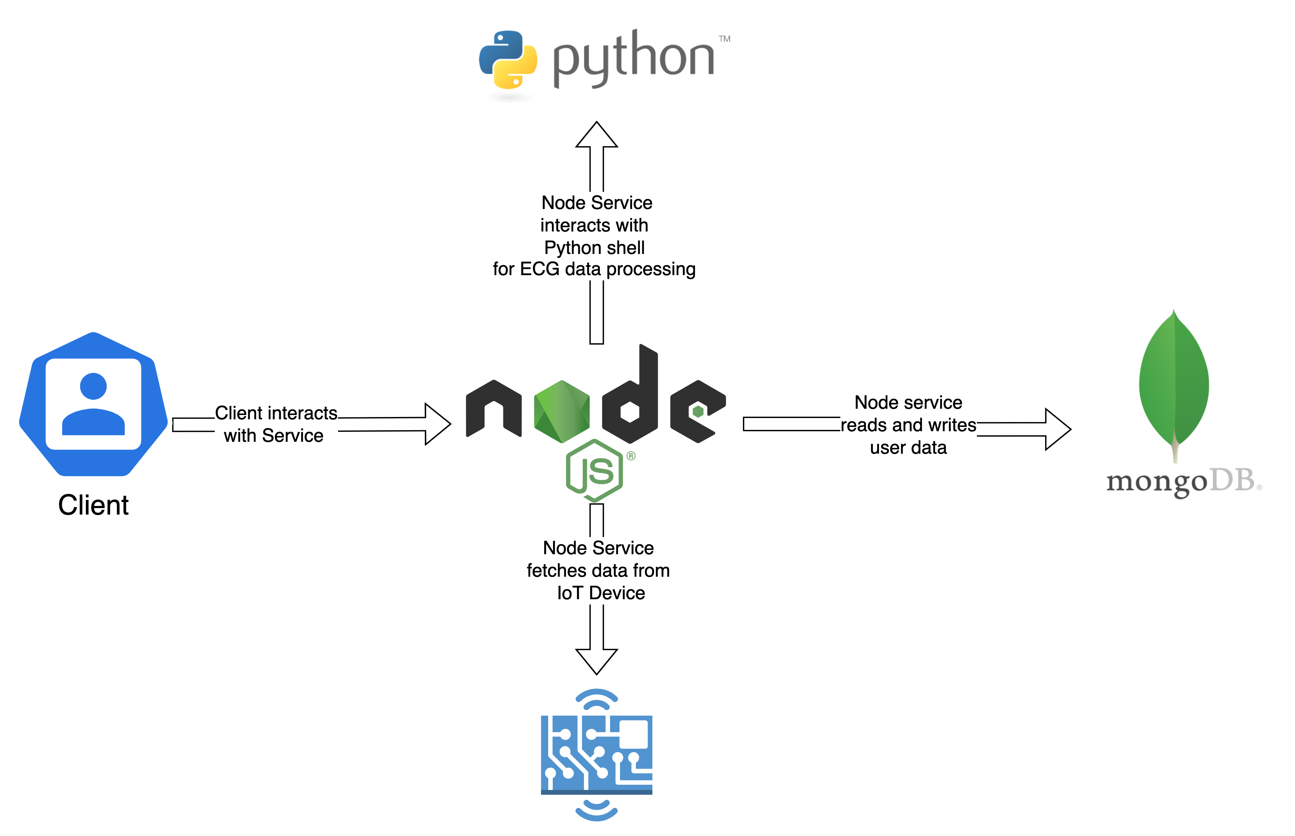
Data Flow

Slide 17
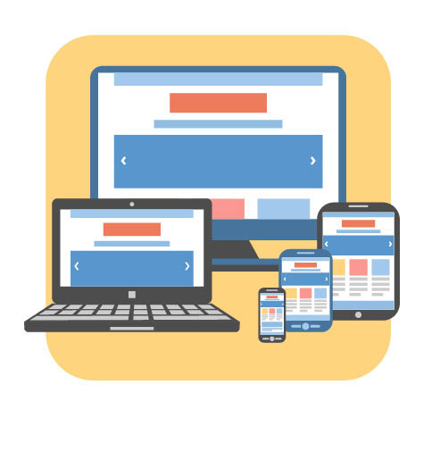
Web Application Screens
Login Page
Home Page
Doctors
Doctor’s Profile
Patient Profile
Temperature Page
Pulse rate Page
ECG Diagnosis

Slide 18
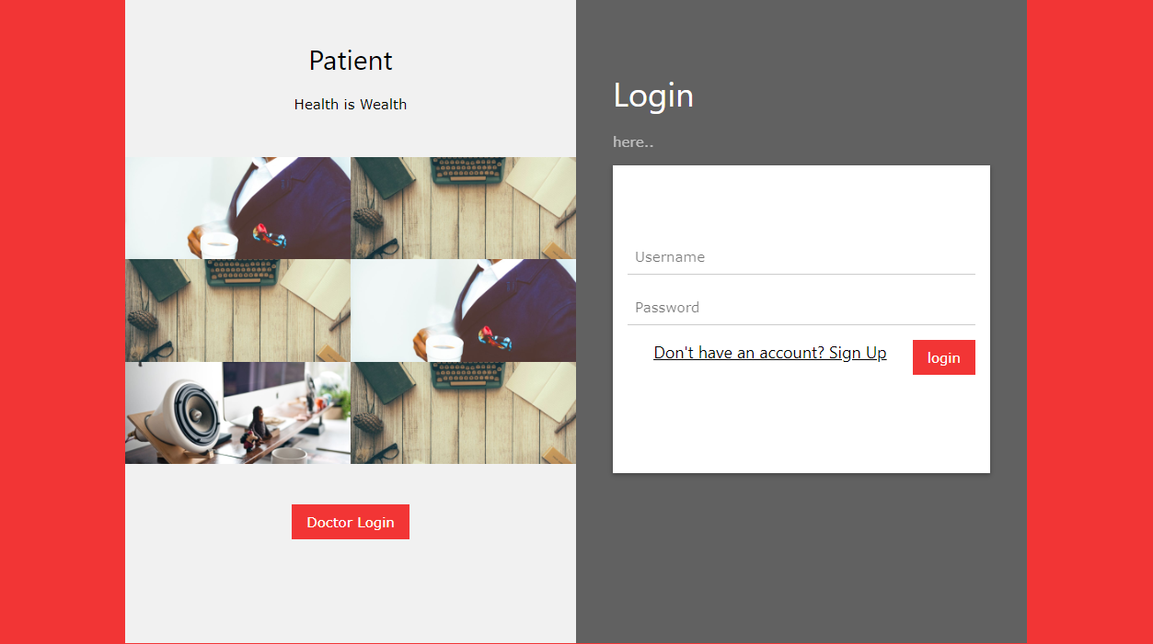

Slide 19
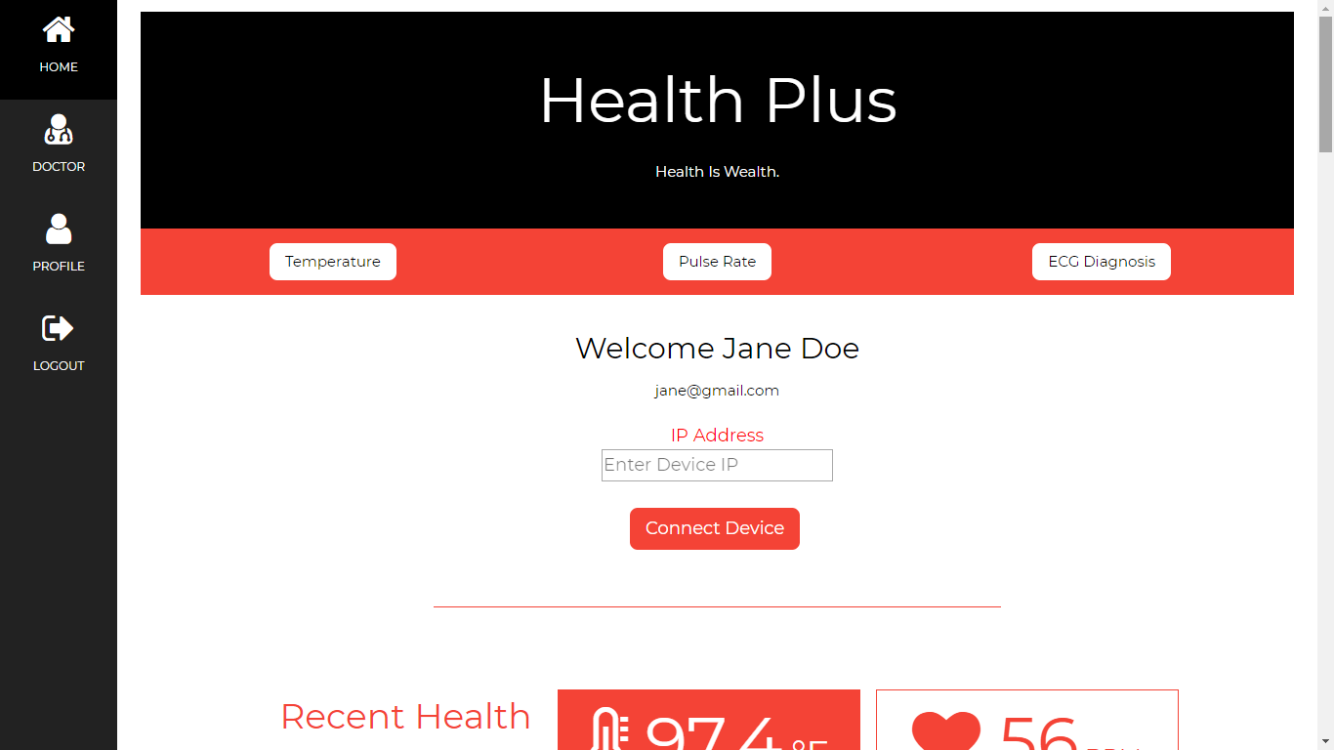

Slide 20
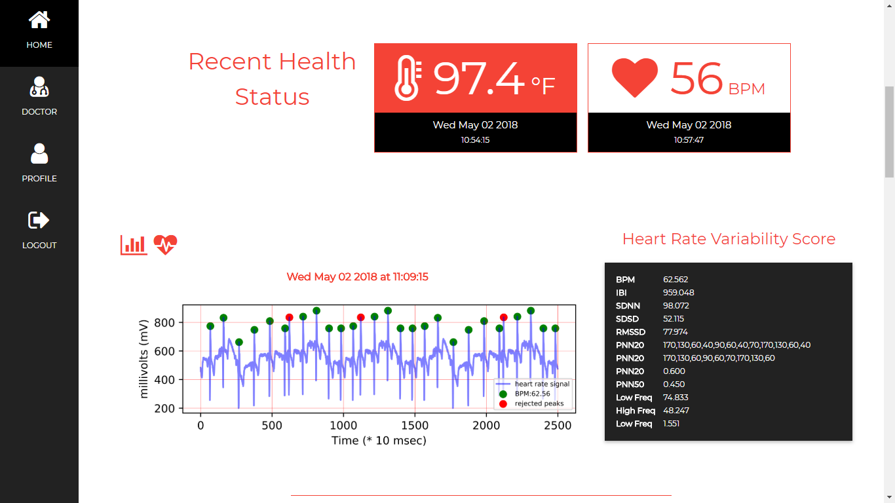

Slide 21
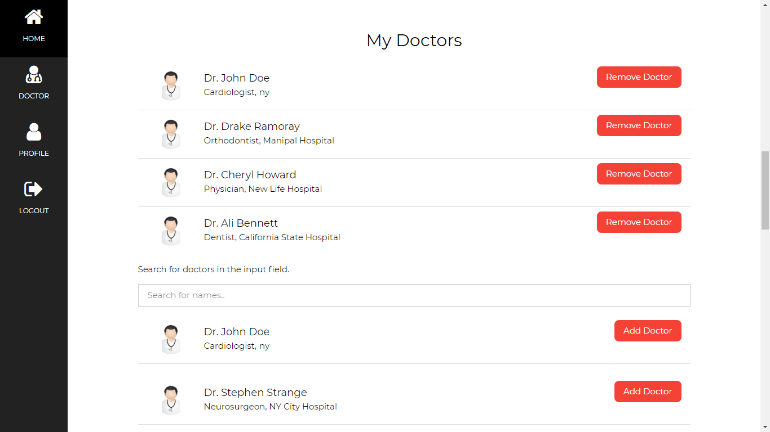

Slide 22
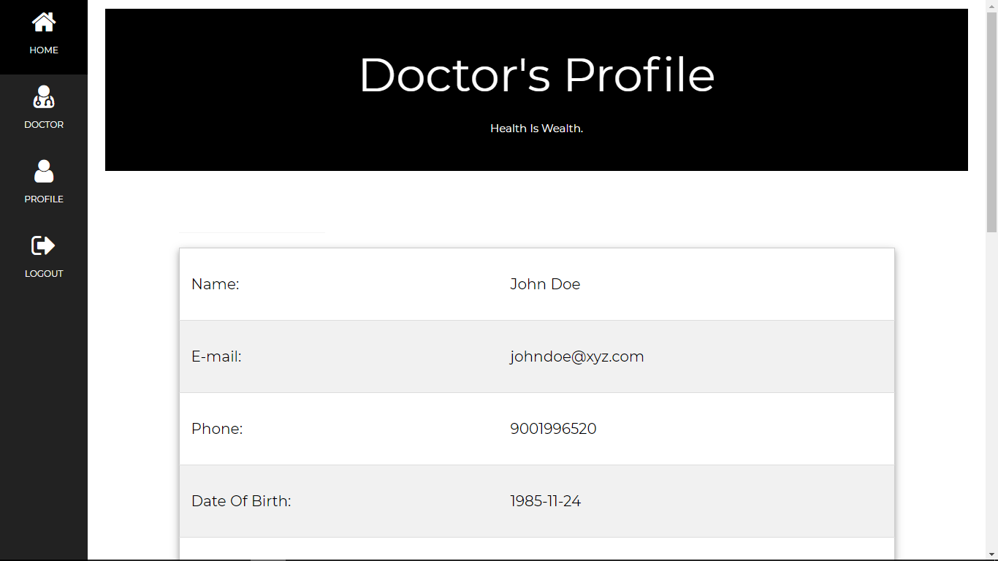

Slide 23
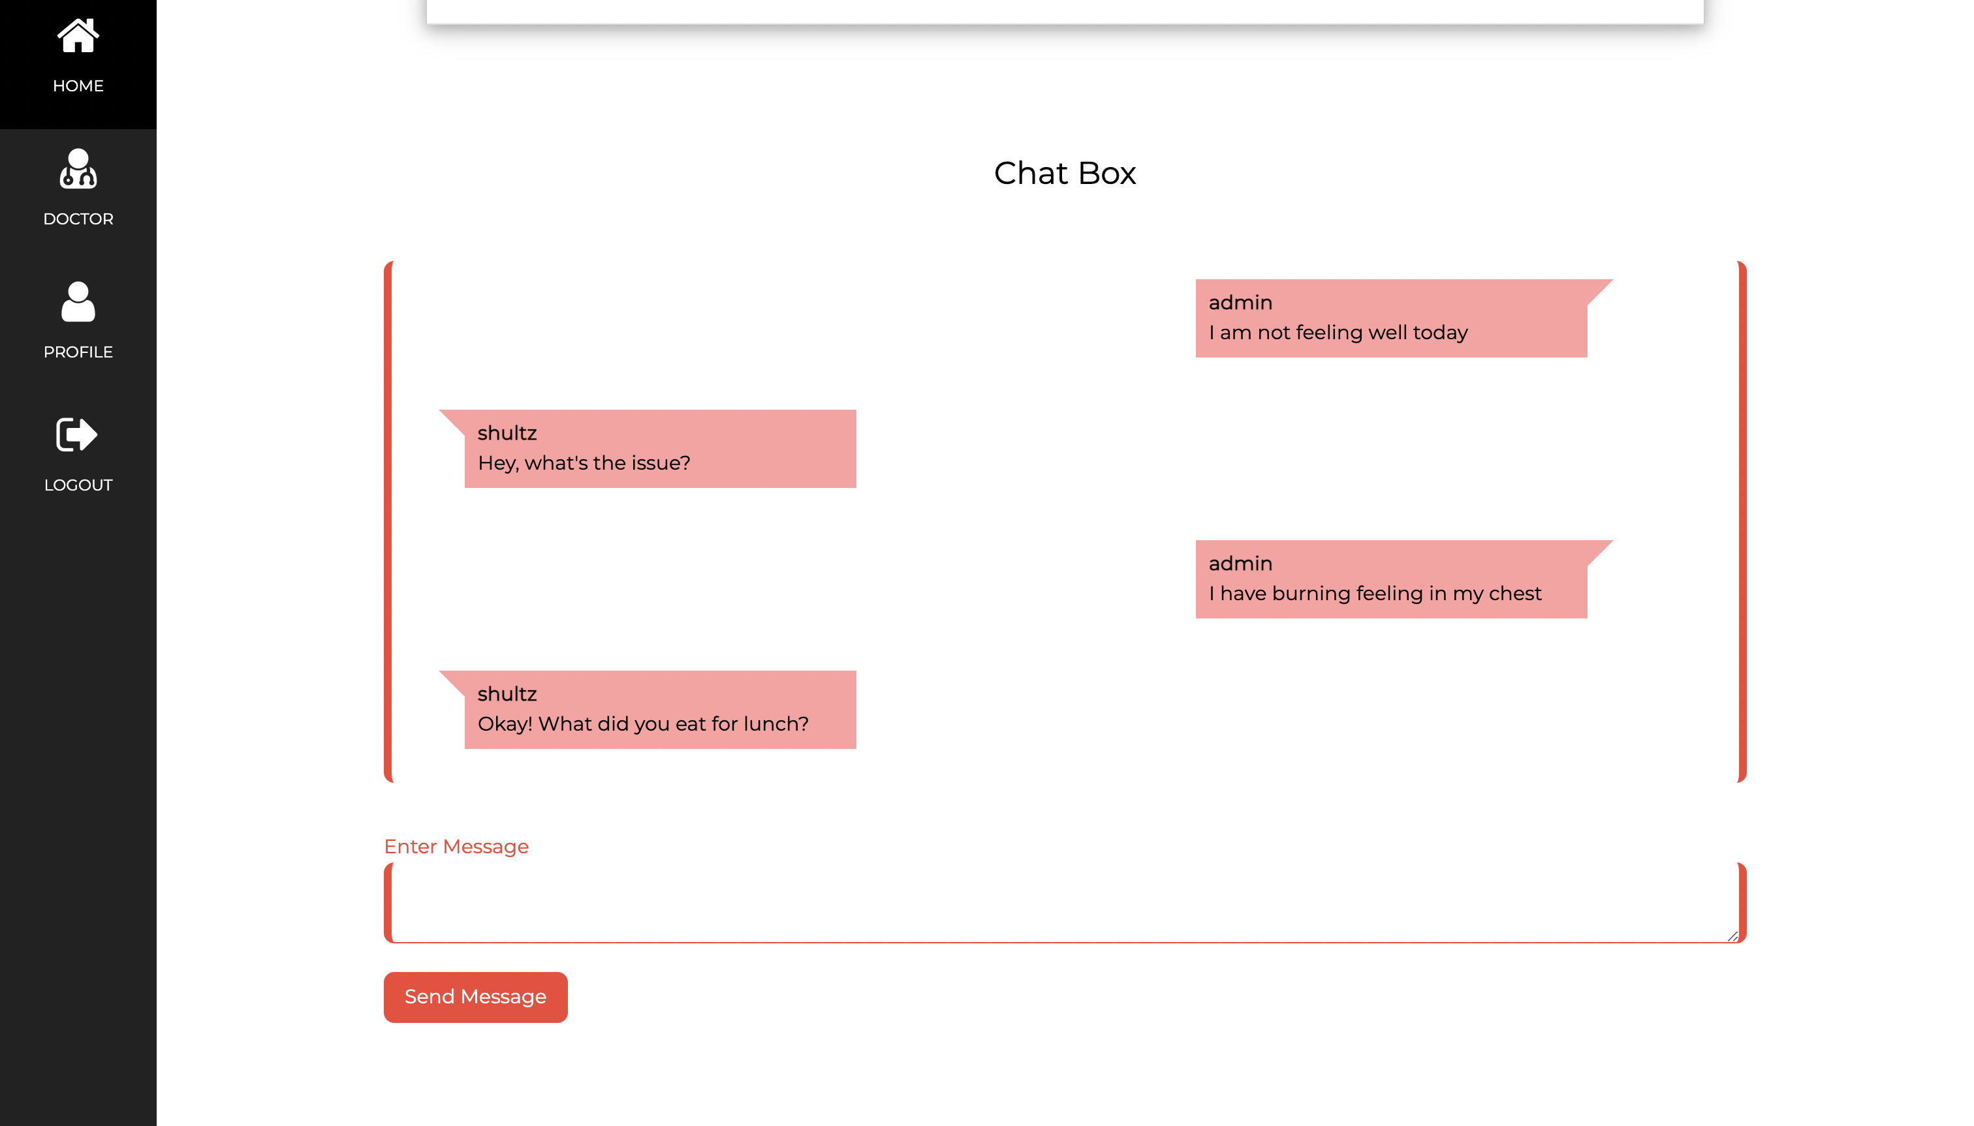

Slide 24
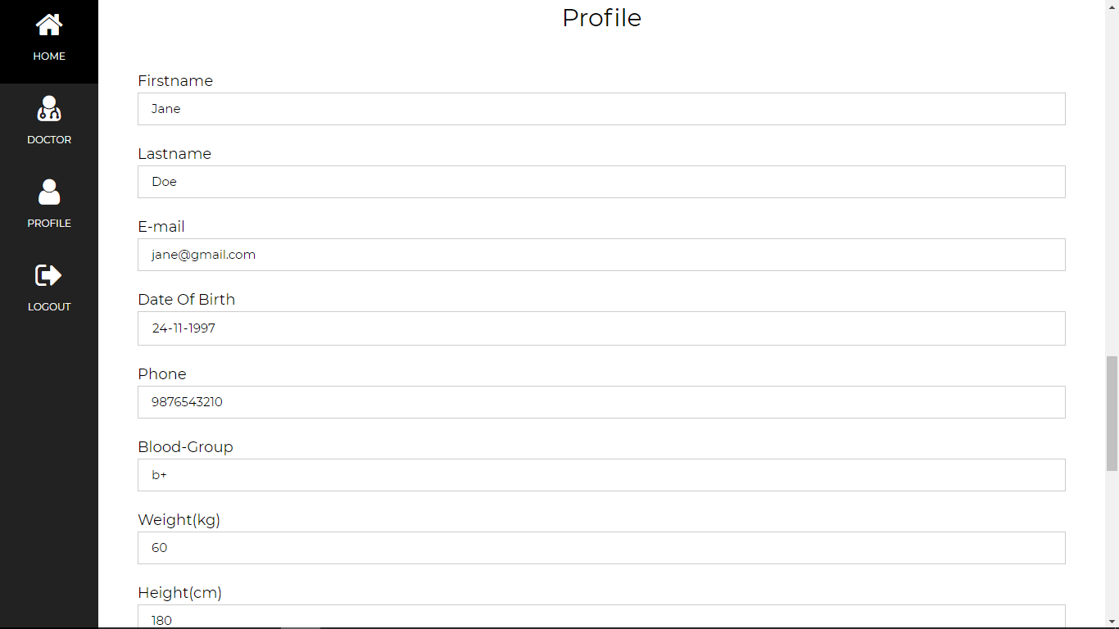

Slide 25
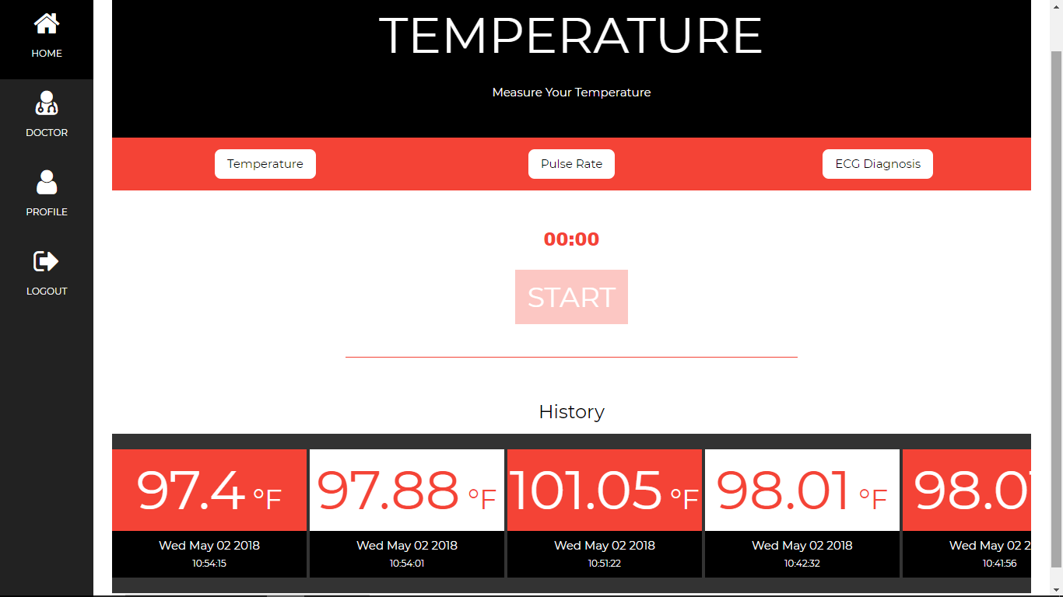

Slide 26
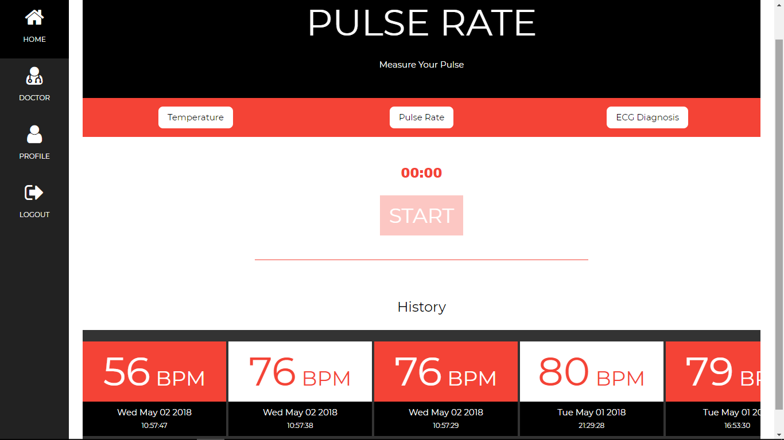

Slide 27
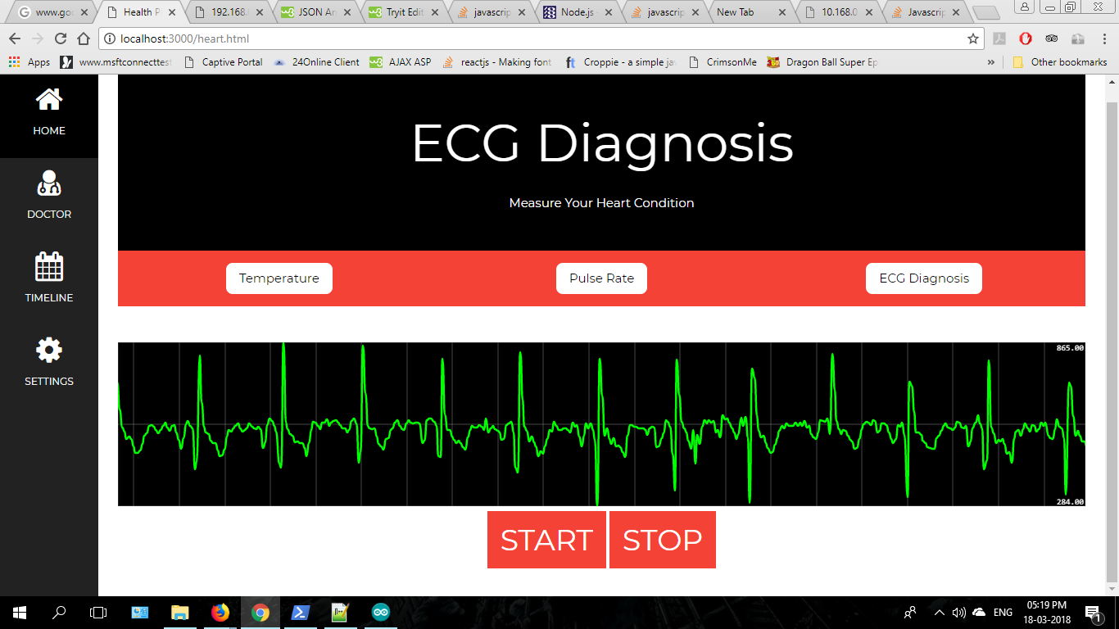

Slide 28
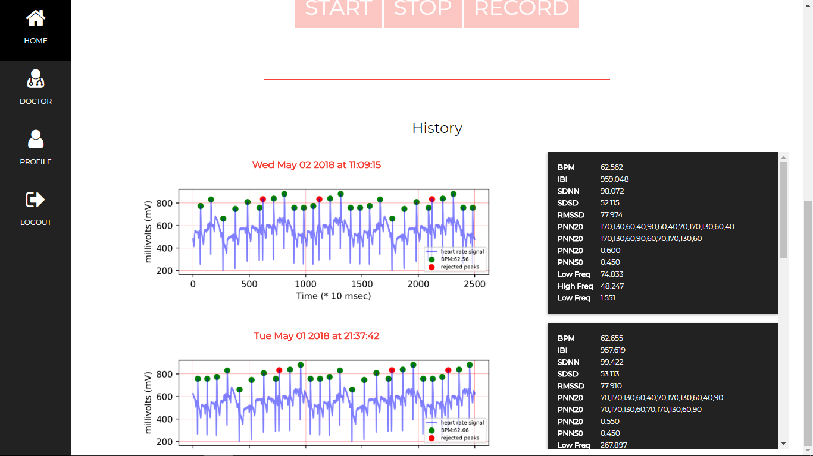

Slide 29
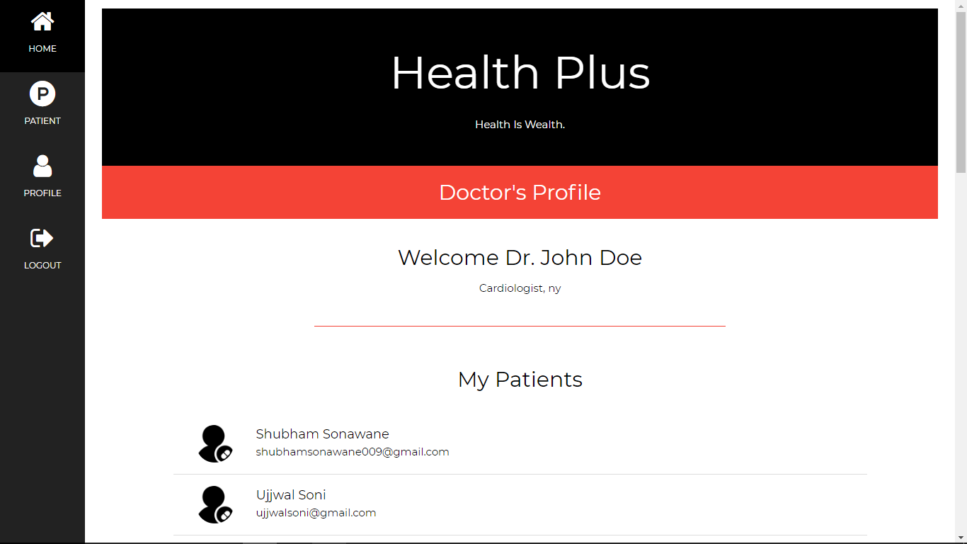

Slide 30
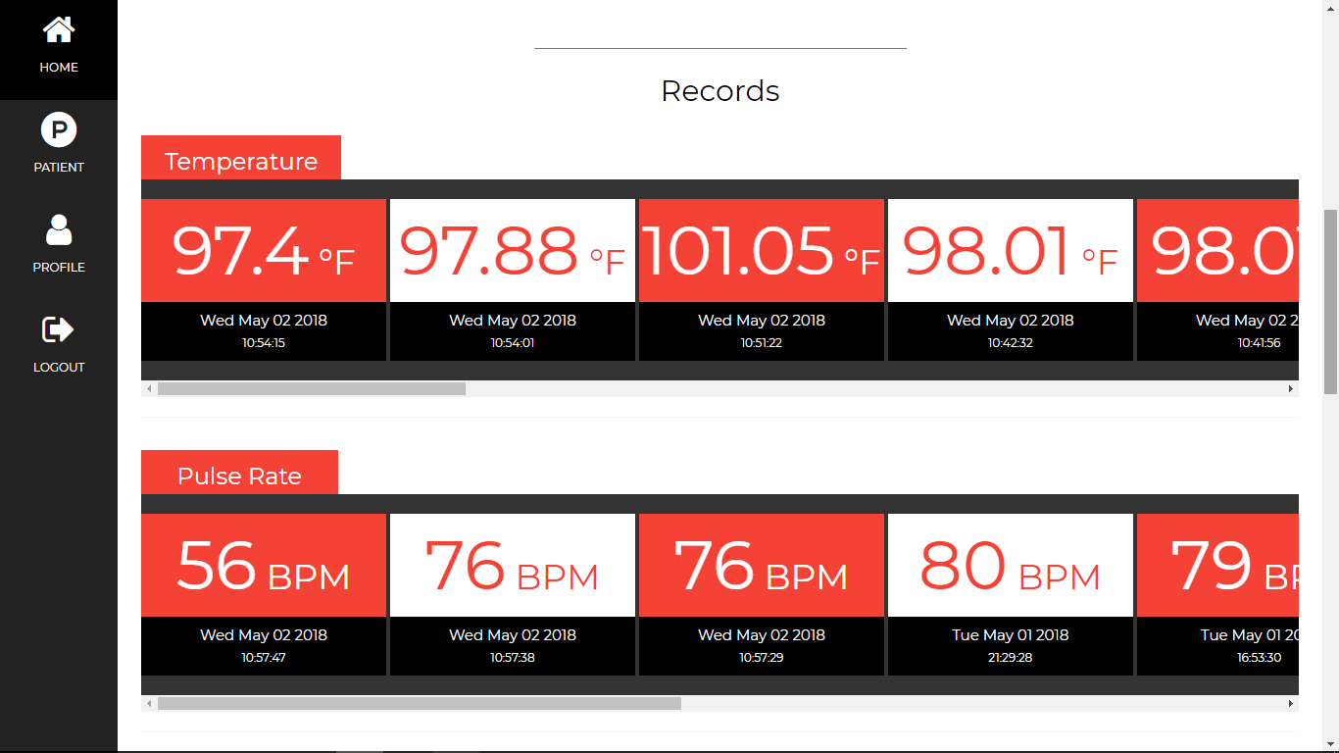

Slide 31
Live Web-App Link
https://health-plus-web.herokuapp.com
Publication
https://link.springer.com/chapter/10.1007/978-981-13-1280-9_1

Slide 32

Code Base

Slide 33

Conclusion And Future Work
More sensors like body composition sensors, blood pressure, insulin and sugar monitor, RBC, WBC and platelet monitors can be added to the system
The system can be made compatible with popular home Automation AI like Google Home’s Google Assistant and Amazon Echo’s Alexa to provide more immersive experience.
System can be integrated with a wearable devices to ease the task.

Slide 34
Thank You

